Slide 1
SIR MODEL FOR
NEW YORK COVID-19 DATA
Abdul Rehman, Rishabh Shanbhag, Yashvin Jagarlamudi

Slide 2
Introduction
SIR model is an epidemiological model which divides the population into various states of health to determine the number of people impacted by a disease over time
SIR models explain the rate of change of people who need medical attention related to a certain disease
For our model, we have considered COVID-19 and a subset containing only New York state’s data
Our SIR model will forecast the immunity of New York residents across 148 days

Slide 3
Limitations of SIR Models
Time varying infectivity
causes infective rate of a disease to change over a period of time leading to sporadic predictions
Super Infection Rate
super infection occurs when a patient contracts a heterologous strain of a disease without recovering first
Super infection makes it difficult to model recovery rate
Ex: HIV and tuberculosis
Latency period
SIR models don’t account for the period between between individual is exposed to a disease and when that individual becomes infected and contagious.

Slide 4
Overview of SIR Model
SIR models contain 3 states: Susceptible, Infected, and Recovered
Susceptible : number of people who haven’t contracted the disease but are likely to in the future
Infected: number of people who have contracted the disease
Recovered: the number of people who have survived and hence achieved immunity from the disease
SIR models also contain various hyperparameters such as :
γ : proportion of infected recovering per day
β : amount of people an infected person will infect per day
R₀ : total number of people an infected person infects
Σ : rate of change of exposed per infected

Slide 5
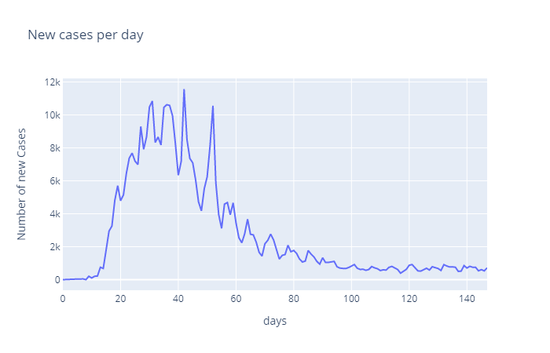
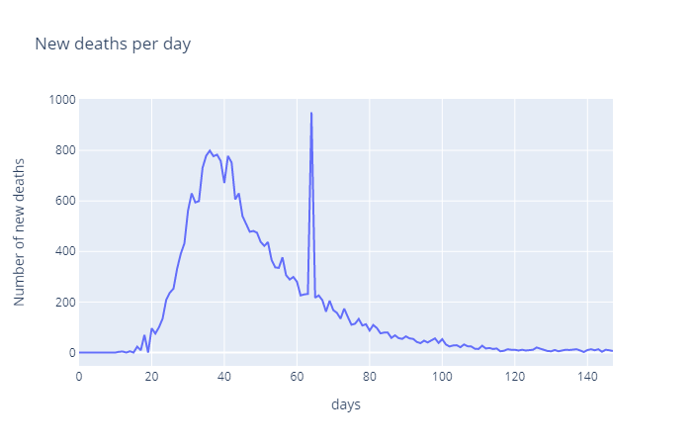
EDA

Slide 6
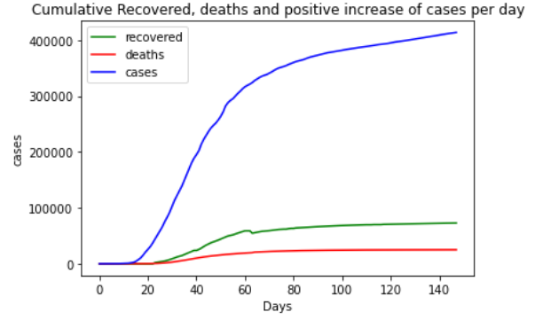
EDA

Slide 7
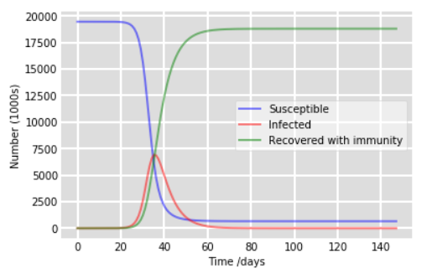
Basic SIR model with estimated parameters
SIR Curve for γ=0.7 and β=0.2

Slide 8
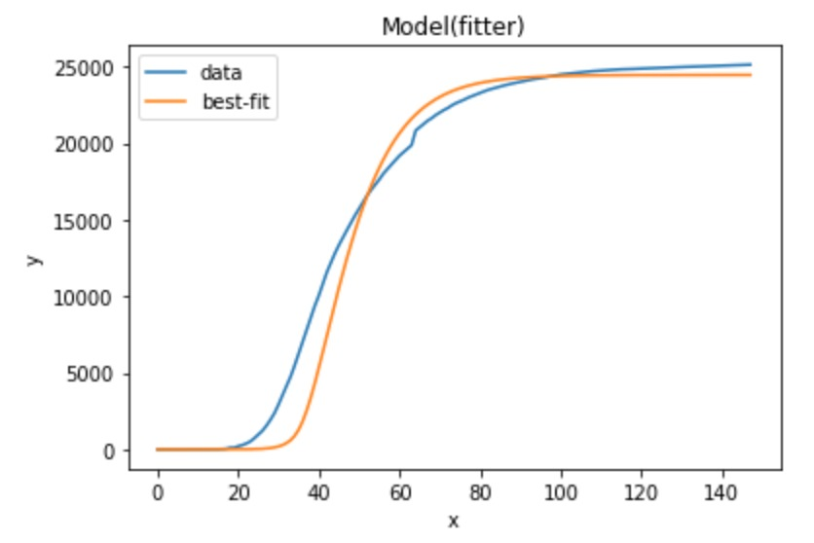
SEIRCD model fit to deaths data
Rate of change from Exposed to Infected: 0.49
Rate of change from Infected to Recovered: 0.19
Rate of change from Infected to Critical: 0.099
Rate of change from Critical to Recovered: 0.125
Rate of change from Critical to Death: 0.16
Probability from Infected to Critical: 0.09
Probability from Critical to Death: 0.79
Probability from Infected to Recovered: 0.91
Probability from Critical to Recovered: 0.21

Slide 9
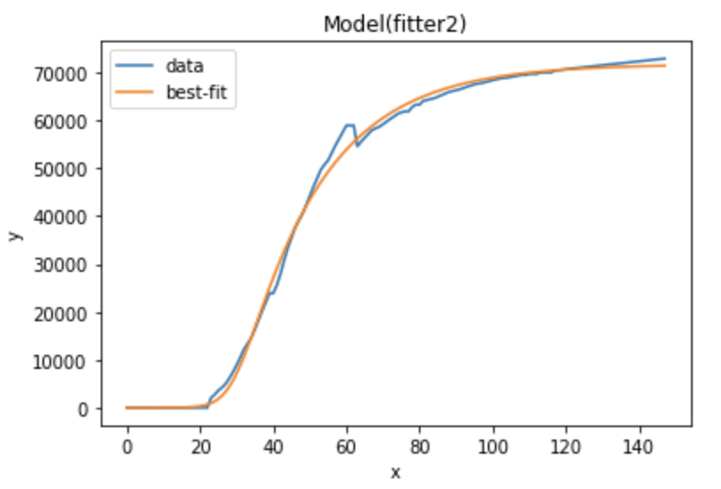
SEIRCD model fit to recovered data
Rate of change from Exposed to Infected: 0.49
Rate of change from Infected to Recovered: 0.19
Rate of change from Infected to Critical: 0.076
Rate of change from Critical to Recovered: 0.19
Rate of change from Critical to Death: 0.16
Probability from Infected to Critical: 0.09
Probability from Critical to Death: 0.05
Probability from Infected to Recovered: 0.91
Probability from Critical to Recovered: 0.95

Slide 10
Conclusion and Future Scope of SEIRCD Model
SEIRCD model can be enhanced to include other components like Hospitalized (H) and on Ventilator (V)
The current SIR model can be generalized to other states in the United States or other countries.
Instead of displaying short-term statistics of COVID-19 for 148 days , the model can be extended to forecast rate of infection until 2021.
Compare SIR predictions using various deep learning models

